Slide 1
Federal Public Lands: Heart of the Rocky Mountain West
University of Denver
Rocky Mountain Land Use Institute
25th Annual Conference
March 10, 2016
Robert B. Keiter
Wallace Stegner Professor of Law
University of Utah S.J. Quinney College of Law
robert.keiter@law.utah.edu
Thanks to Matt McKinney, John Ruple, Sheena Christman
Panelists:
Ann Morgan – Public Lands Consultant
Rebecca Watson – Atty., Welborn firm

Slide 2
The Fast Growing American West
1970 – 15% U.S. popul.
2030 – 25% U.S. popul.
3 fastest growing states, 1976-2015: NV, AZ, UT
West’s fastest growing counties abut public lands/wilderness areas
Urbanization – 5 Western
Megaregions:
3 – Pacific Coast
1 – Denver-Front Range
1 – Phoenix-Tucson

Slide 3
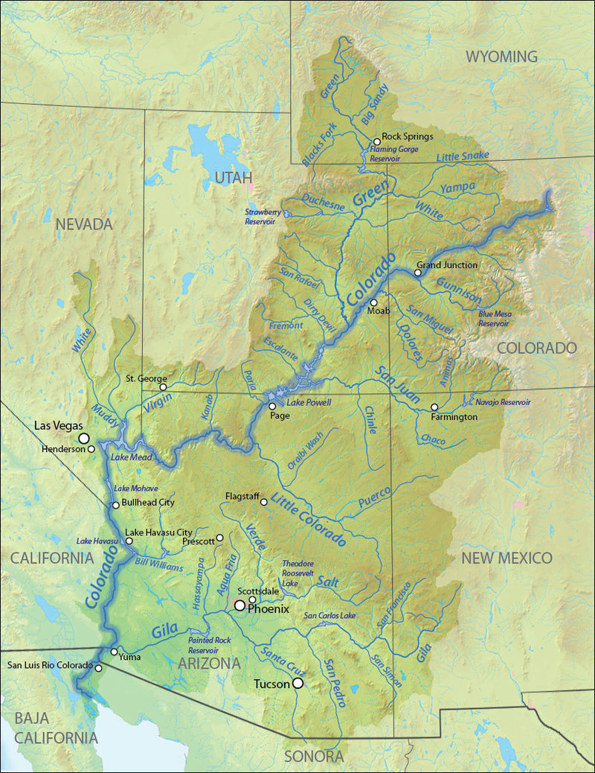
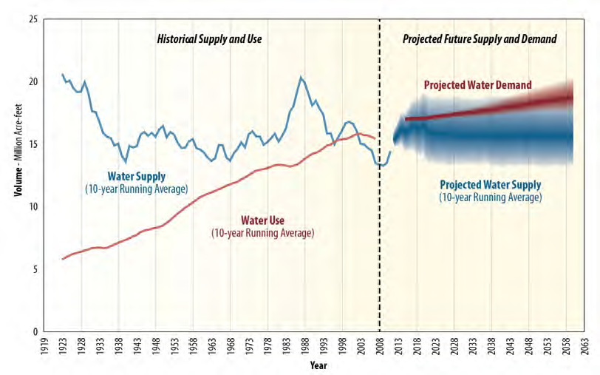
Limited Water
“About 90 percent of the drinking water for Las Vegas comes from Lake Mead, the Colorado River reservoir created by Hoover Dam. As of early August the lake was only 38 percent full—a historic low.”
Bureau of Reclamation, Colo. R. Basin Study

Slide 4
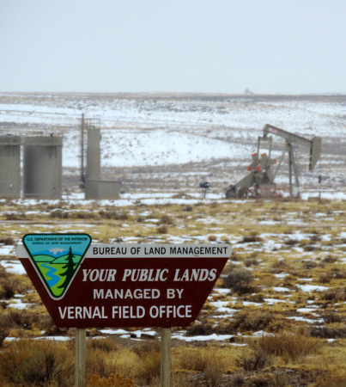
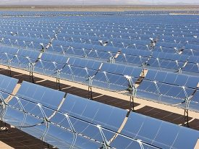
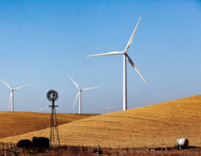
Energy Development
35 million acres – leased (oil/gas)
12.7 million acres – producing
19 million acres – solar potential
20 million acres –wind potential
50% US coal from federal lands
Notes:
Drilling in Utah. Retrieved from: http://energyblog.nationalgeographic.com/2015/03/20/new-u-s-fracking-rules-earn-disdain-from-both-sides-and-a-lawsuit/
Solar project. Retrieved from: http://www.blm.gov/wo/st/en/prog/energy/solar_energy.html
Wind towers. Random website.
http://www.fws.gov/cno/energy.html

Slide 5
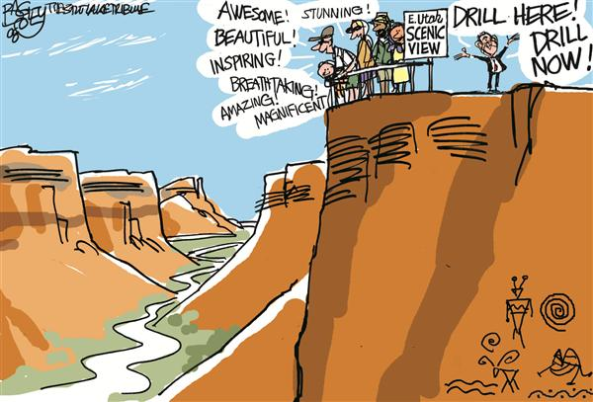
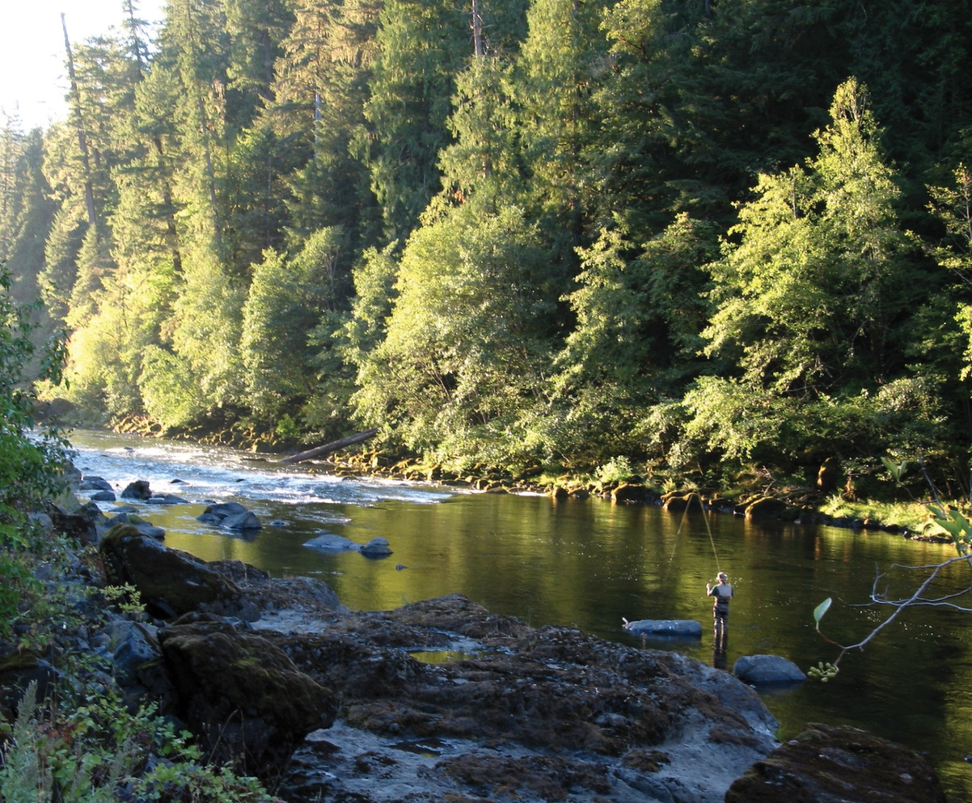
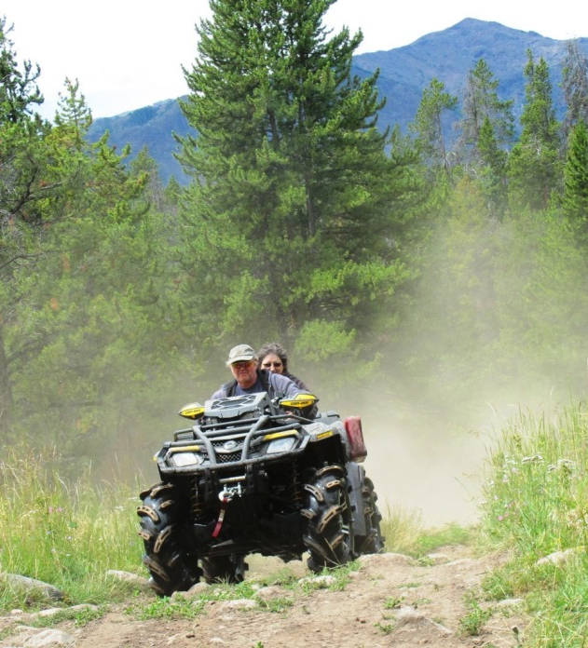
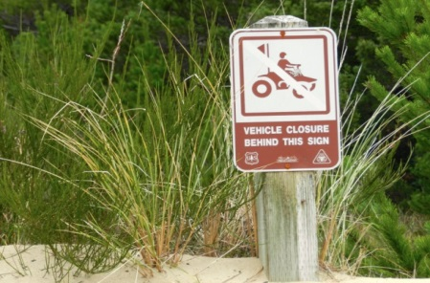
Recreational & Environmental Values
l
Notes:
ATV Riders in the Shoshone National Forest, Montana. Retrieved from: http://billingsgazette.com/lifestyles/recreation/atv-route/image_2c99abee-ffd6-5d0a-9e2f-043e16433d29.html
Fishing on public lands in Oregon. Retrieved from: Oregon: https://www.flickr.com/photos/mypubliclands/23202567601/in/album-72157661518852226/
Miscellaneous photo.

Slide 6
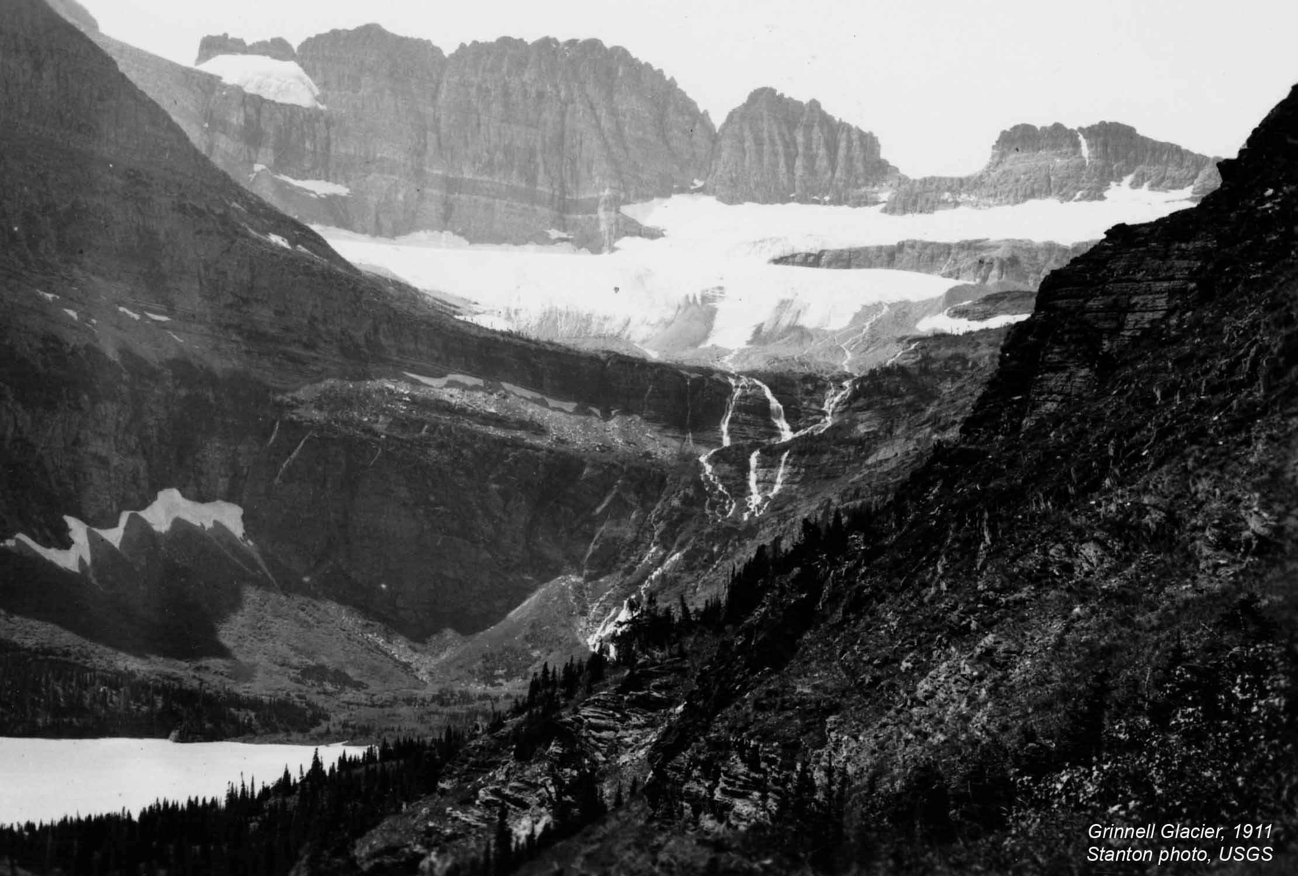
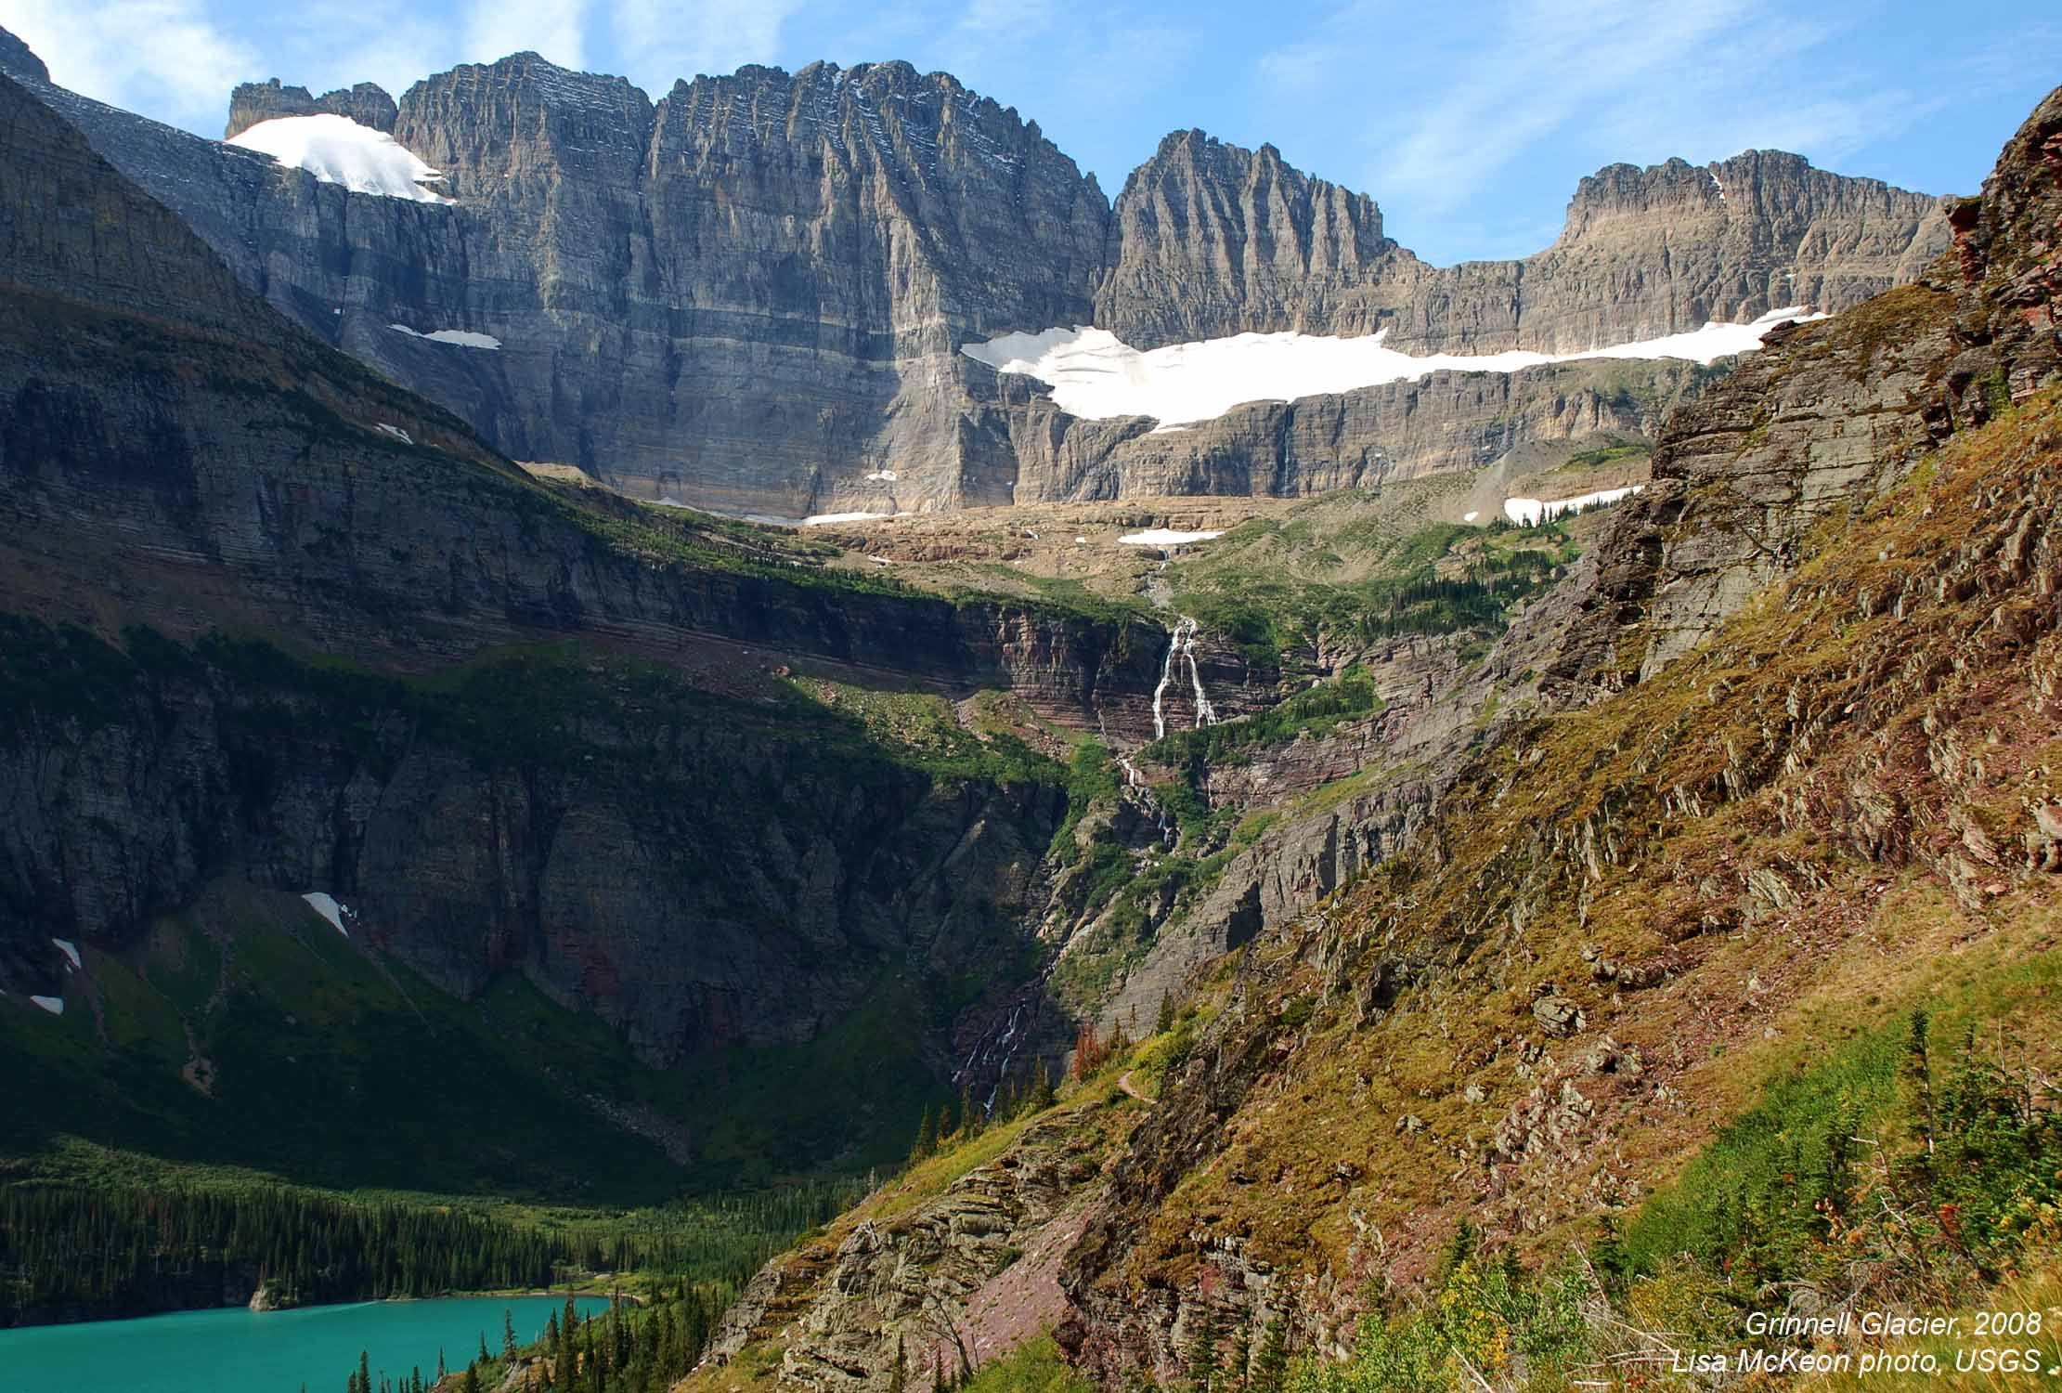
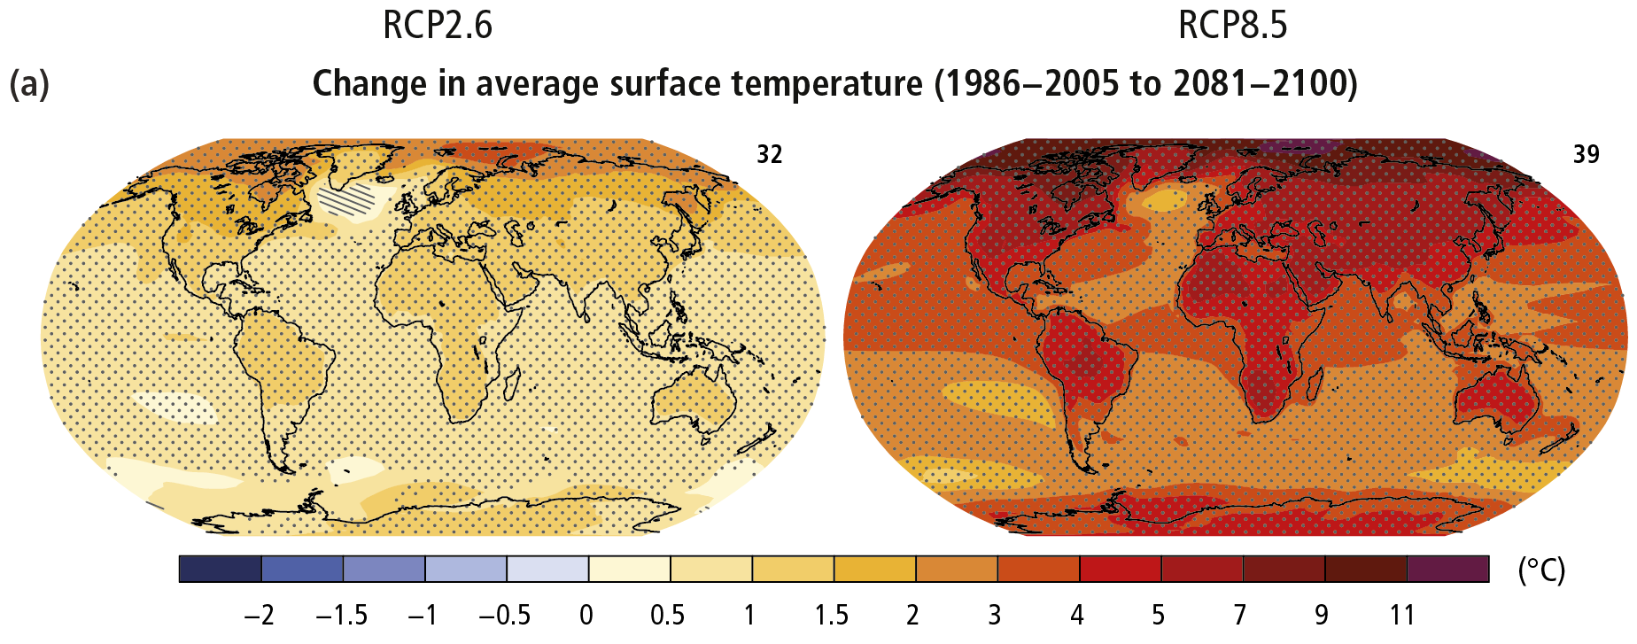
Climate Change Impacts
Grinnell Glacier, Glacier National Park
Grinnell Glacier
Glacier National Park
1911
2008
1911
2008
Notes:
Grinnell Glacier, Montana: 1911 (L) and 2008 (R). Photos retrieved from: http://www.nrmsc.usgs.gov/repeatphoto/gg_trail11-08.htm

Slide 7
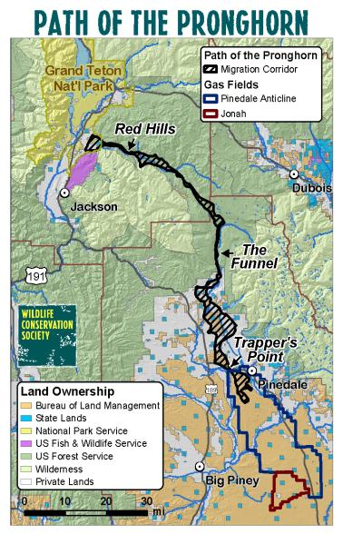
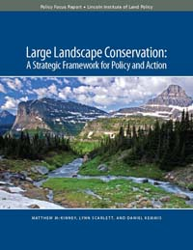
Ecology & Ecosystem Management
Land management plans guide sustainable, integrated resource management of the resources within the plan area in the context of the broader landscape, giving due consideration to the relative values of the various resources in particular areas. 36 CFR 219.1(b) (USFS NFMA Planning Rules)
The responsible official shall use the best available scientific information to inform the planning process required by this subpart. 36 CFR 219.3

Slide 8
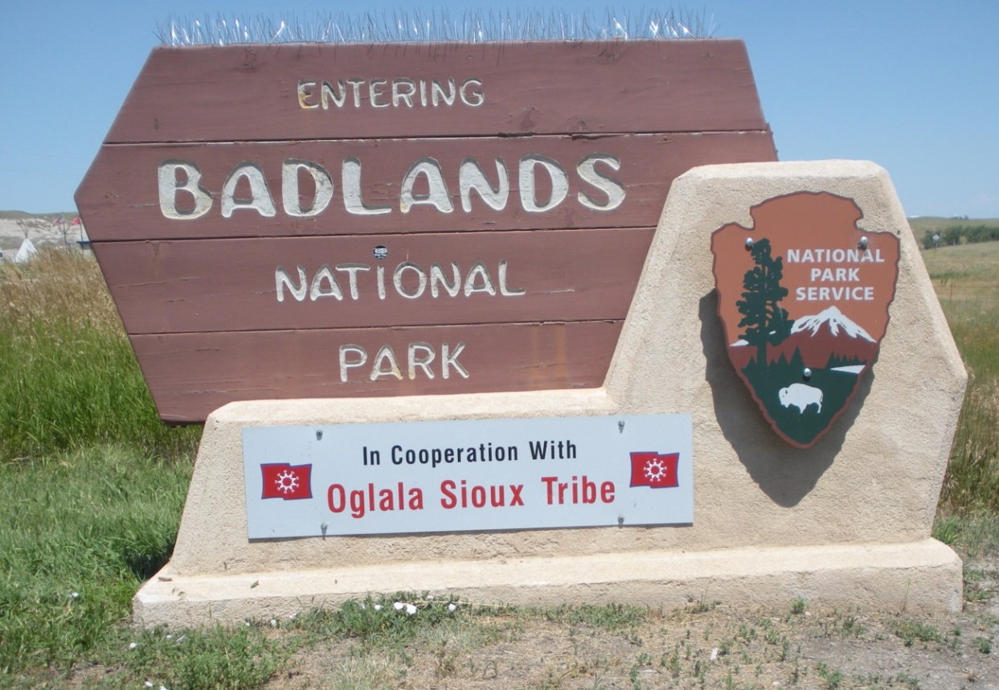
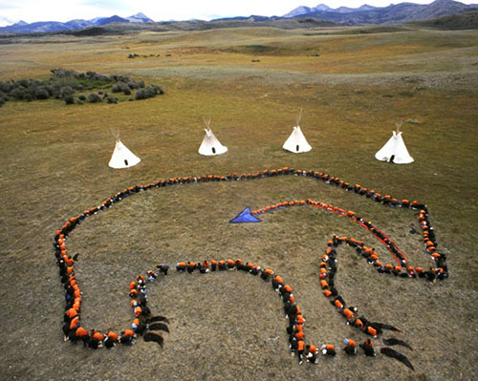
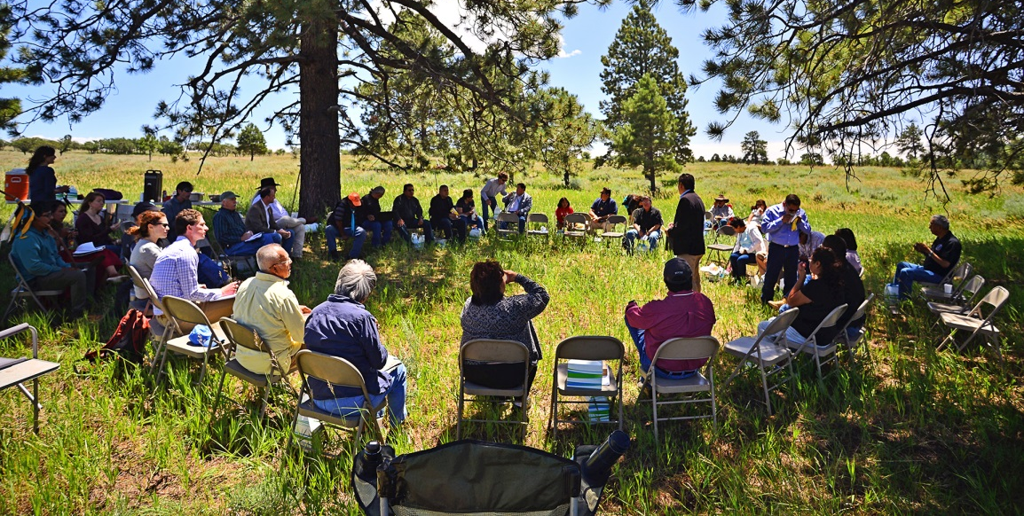
Native American Role
Blackfeet Traditional Cultural District, Badger-Two Medicine, Lewis & Clark National Forest, Montana
Intertribal Coalition, Bears Ears National Monument proposal, San Juan County, Utah
Notes:
Bottom-Right: Bears Ears Inter Tribal Coalition meet to discuss support of Bear Ears National Monument designation, and tribal-federal management coordination should a designation be made. Retrieved from: http://www.bearsearscoalition.org/about-the-coalition/
Top-Right: Sculptures marking the start of Blackfeet Country, Glacier National Park. Retrieved from Glacier National Park facebook page: https://www.facebook.com/GlacierNPS/photos_stream?ref=page_internal
Top-Left: Entrance to Badlands National Park. Retrieved from: https://www.flickr.com/photos/badlandsnationalpark/9343623447/in/album-72157632302826657/
Bottom-Left: Meeting between the Kalamath Tribe (Oregon) and the Forest Service. Retrieved from: https://www.facebook.com/KlamathTribes/photos/pb.235615603185650.-2207520000.1457202526./955264837887386/?type=3&theater

Slide 9
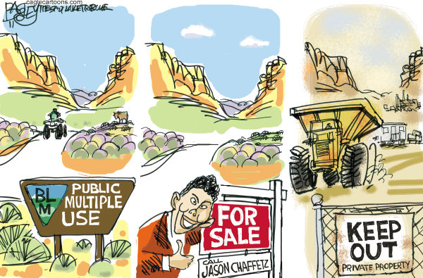
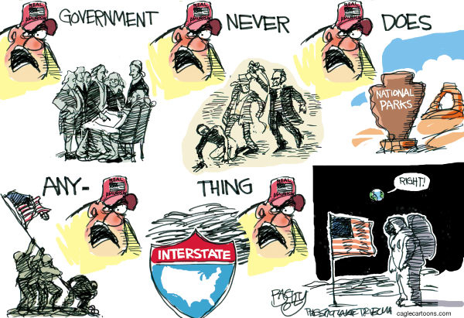
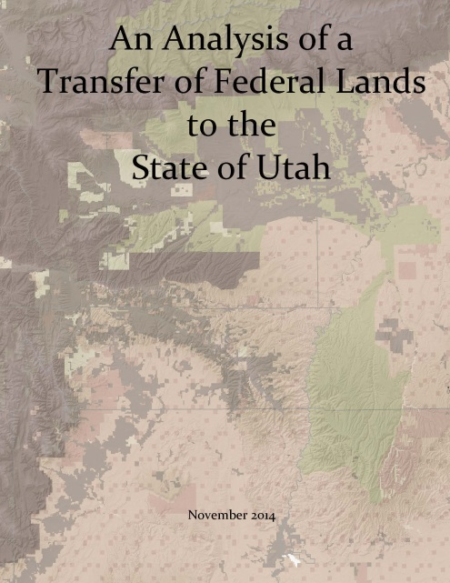
Federal – State Tensions
“Republicans okay $14 million land-transfer lawsuit; say Utah must regain sovereignty,” Salt Lake Tribune, Dec. 9, 2015

Slide 10
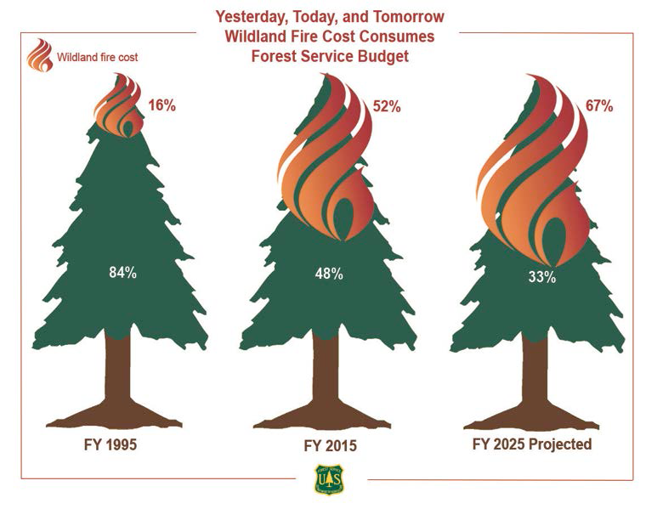
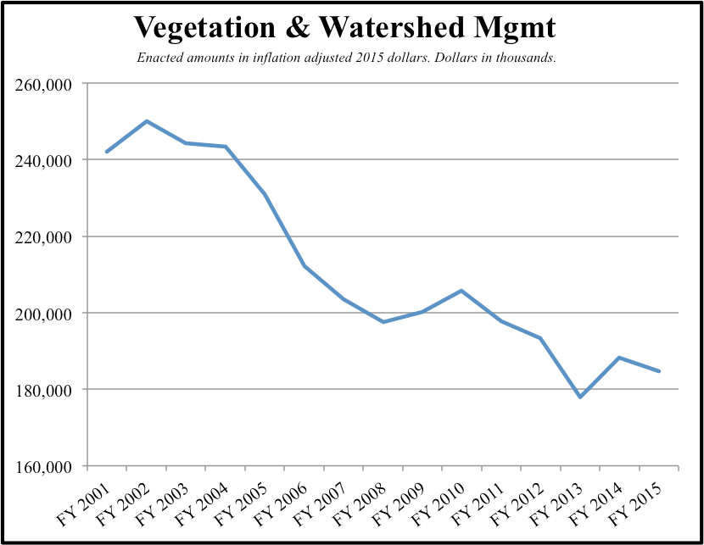
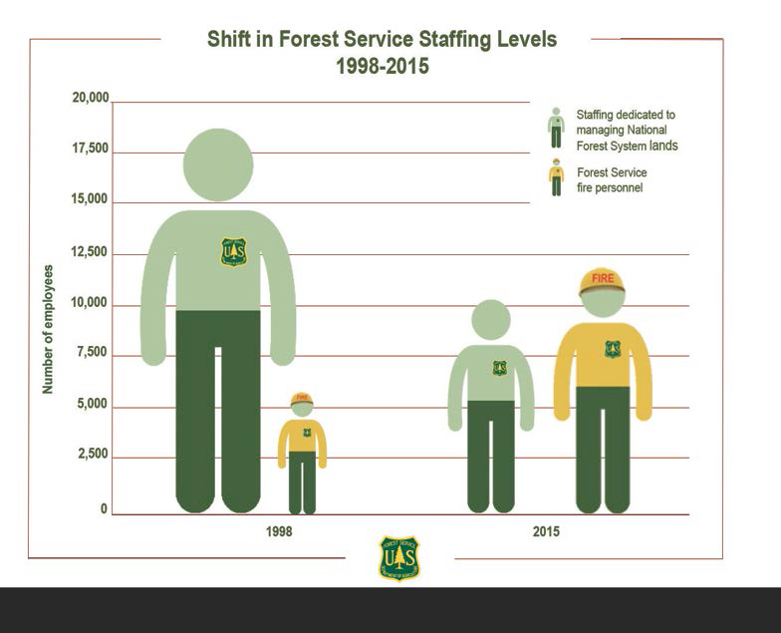
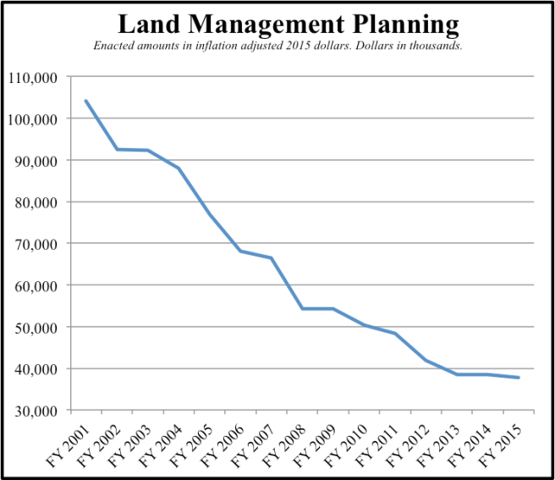
Agency Capacity/Funding

Slide 11
Legal Complexity
Laws governing the public lands:
Administrative Procedures Act
National Environmental Policy Act
Endangered Species Act
National Forest Management Act
Federal Land Policy and Management Act
Multiple Use - Sustained Yield Act
General Mining Law
Mineral Leasing Act
Taylor Grazing Act
The Wilderness Act
Antiquities Act
The Wild Free-Roaming Horses and Burros Act
Surface Mining Control and Reclamation Act of 1978
Cultural and Historic Protection and Preservation Acts
Clean Water Act
Clean Air Act
Equal Access to Justice Act
Etc.
“There is an evident need for Congress to enact a single, comprehensive statute for the regulation of federal lands.” Calif. Coastal Comm’n v. Granite Rock Co., 480 U.S. 572 (1987) (Powell, J., dissenting)
“The Process Predicament: How Statutory, Regulatory, and Administrative Factors Affect National Forest Management,” U.S. Forest Service, 2002

Slide 12
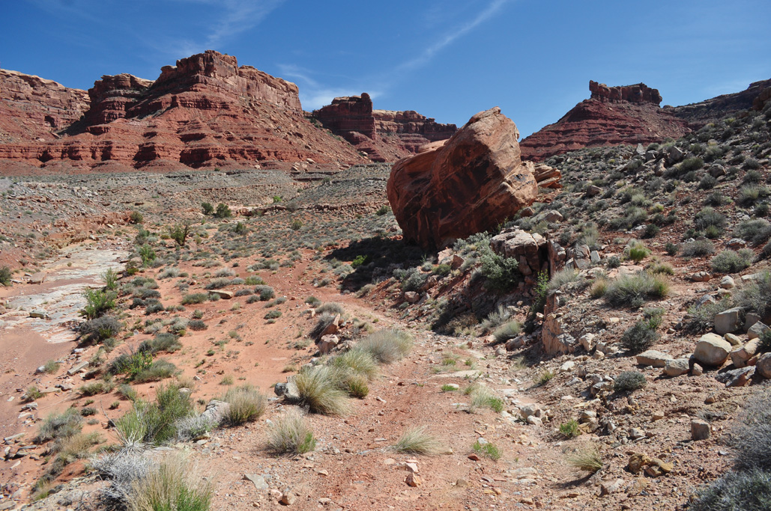
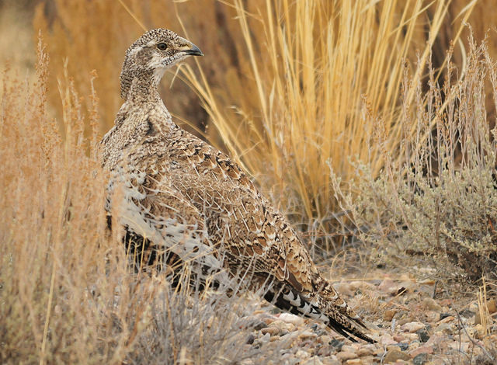
The Judicial Role
The court ruling in Seattle Audubon Society v. Evans (1991) ended large-scale commercial logging in Pacific Northwest national forests.
RS 2477 Claim in the Glen Canyon National Recreation area
The State of Utah has filed approximately “12,000 RS 2477 claims in national parks, two wilderness areas, two national wildlife refuges, proposed wilderness areas and wilderness study areas, and the Grand Staircase-Escalante National Monument.” SUWA, 2012
On Feb. 25, 2016, conservation groups filed a lawsuit in response to the US Fish & Wildlife Service’s decision to not list the greater sage-grouse.
“Utah officials on Thursday filed a lawsuit seeking to invalidate federal land-use plan revisions aimed at conserving imperiled greater sage grouse.” Salt Lake Tribune, Feb. 4, 2106
Notes:
Image of RS2477 claim and text taken from SUWA’s website. Retrieved from: http://suwa.org/state-of-utah-drops-rs-2477-litigation-bomb/
Northern Spotted Owl taken from the National Wildlife Federation website. Retrieved from: https://www.nwf.org/Wildlife/Wildlife-Library/Birds/Northern-Spotted-Owl.aspx.
Sage grouse image taken from USFWS website. Retrieved from: https://www.flickr.com/photos/usfwsmtnprairie/21868606215/in/pool-2665051@N21/
Announcement of lawsuit filed on 2/25 available here: http://www.biologicaldiversity.org/news/press_releases/2016/greater-sage-grouse-02-25-2016.html

Slide 13
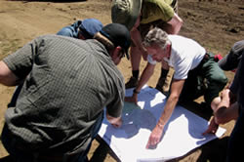
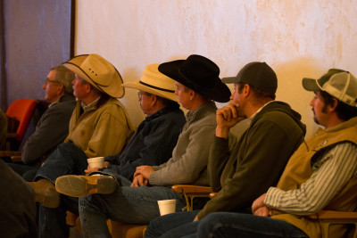
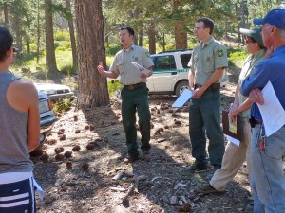
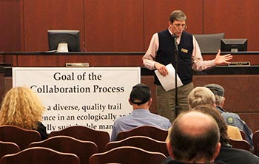
New Collaborative Processes
Notes:
(1) Top-Left: BLM discussing plan for Willamette National Forest, Oregon. Retrieved from: http://www.fs.usda.gov/detail/willamette/landmanagement/resourcemanagement/?cid=stelprdb5436909
(2) Bottom-Left: Forest Service discussing Skyline Trail, California. Retrieved from: http://trailsfoundation.org/skyline-trail-public-meeting/
(3) Top-Right: Landowners listening to a USFWS presentation during the Working Landscapes Regional Collaboration Workshop. Retrieved from: http://refugeassociation.org/2015/03/partners-for-conservation-hosts-first-working-landscapes-regional-collaboration-workshop/
(4) Bottom-right: US Forest Service presentation (in Georgia). Retrieved from: http://www.fs.usda.gov/detailfull/conf/home/?cid=STELPRDB5394453&width=full

Slide 14
The Changing Face of Federal Public Lands
1. Fastest Growing Region
2. Limited Water
3. Energy Development
4. Recreational/Environmental Values
5. Climate Change Impacts
6. Ecology/Ecosystem Mgmt.
7. Native American Role
8. Federal-State Tensions
9. Agency Capacity/Funding
10. Legal Complexity
11. The Judicial Role
12. New Collaborative Processes

Slide 15
Panel Questions
Agree/Disagree? Other important changes?
Implications for law, policy, and governance of public lands? Are changes called for? What changes would you recommend?
How should we promote change? What strategies would you recommend?

